Slide 1
CROP PREDICTING APP
SPRINT-1
Wu Di
Litao Chen
Anindya Paul
Archana Bajaj
10/12/2016

Slide 2
Overview
NASA/Africa
10/10/16
What’s our product?
Detailed understanding of project
Targeted Users
Targeted Customers
Research Slides
Modular and system level diagrams
Next Sprint View

Slide 3

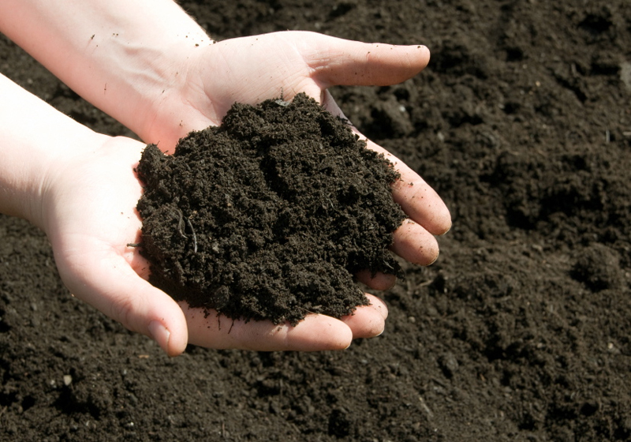

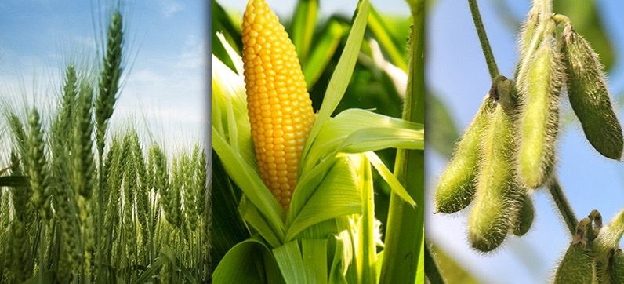
What’s our Project about?
10/10/16
Model Soil
Samples
Develop
application
Predict crops suited for location

Slide 4
What is our product about?
10/10/16
An application that takes input of soil sample data set and models that input to give soil property values.
These property values are used to determine the crops that can be grown around user’s chosen location.
We can further develop the model to provide dealer information on materials required to maintain that crop. E.g. linking it to Amazon.
Our product uses NIR analysis data to update soil sample data in order to give information of more locations.

Slide 5
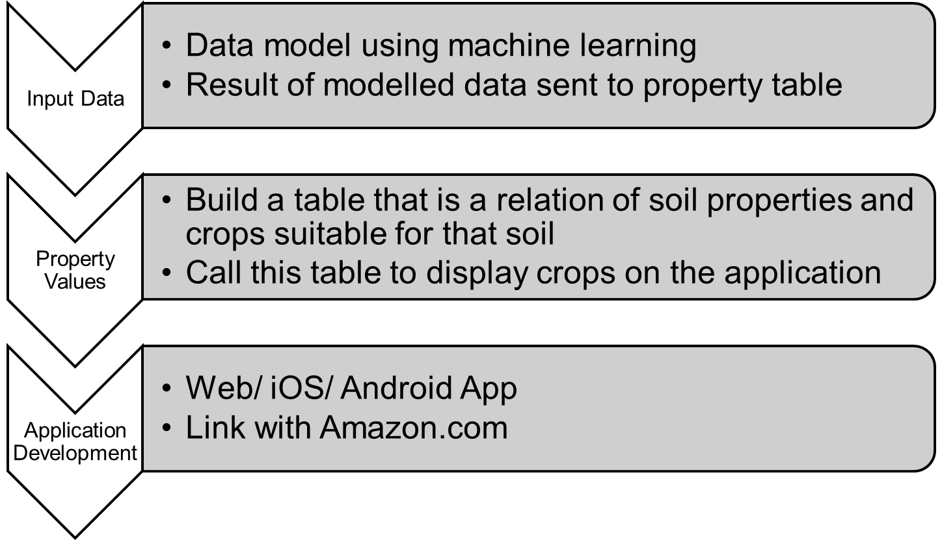
NASA/Africa
10/10/16
Detailed Understanding of project

Slide 6
Targeted users
10/10/16
African Farmers
Agricultural Companies
Agricultural scientists and research areas

Slide 7
Target customers
10/10/16
African governments
Agricultural companies
Agriculture scientists
Agriculture research labs
Amazon (if linked with amazon services)

Slide 8
Research on soil data processing
10/10/16
Machine leaning, supervised learning, regression problem
Preprecessing Methods-first derivative, Savitzky-Golay filter, Haar dwt , Partial PCA,
Regression Model- Neural Networks,SVM
Parameter and feature Choosing

Slide 9
Research on presenting data
10/10/16
Google map API
Android or IOS Web
MySQL as the Database Management system
Research on chemical property values of soil to the crops that can be grown on that soil
www.fda.gov

Slide 10
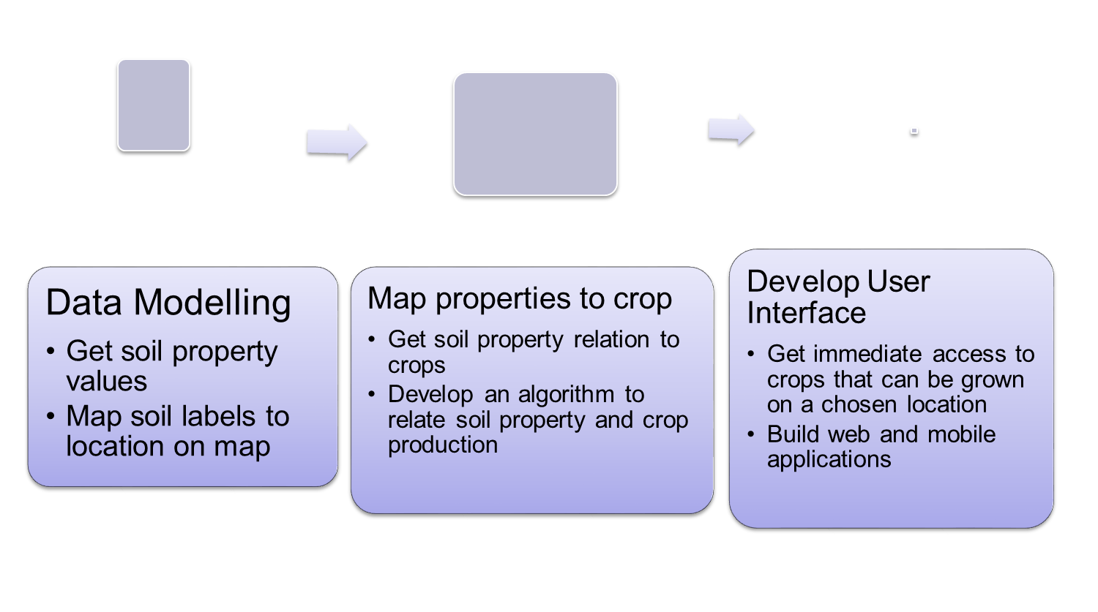
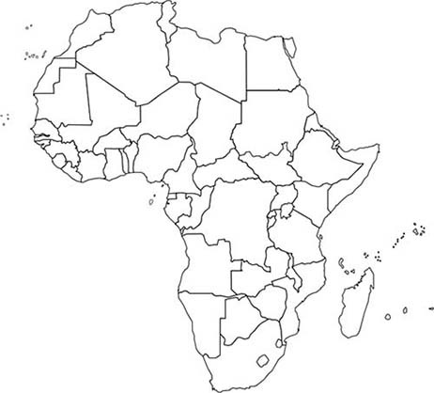
10/10/16
Modular Diagram

Slide 11
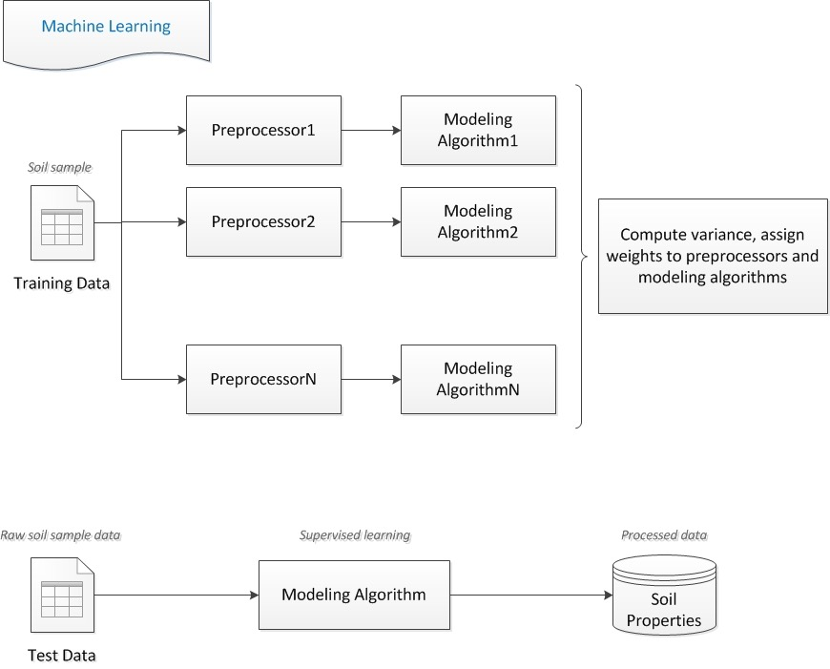
Workflow diagram
10/10/16

Slide 12
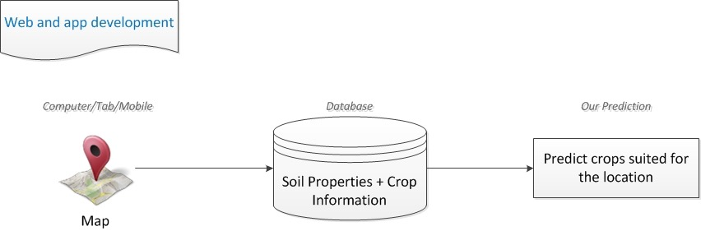
Workflow diagram
10/10/16

Slide 13
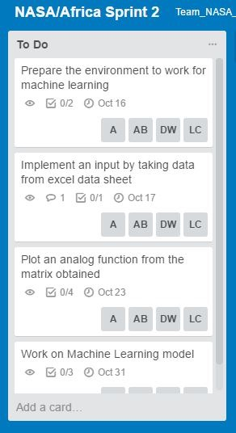
Next Sprint Board
10/10/16

Slide 14
THANK YOU
10/10/16
Questions??

